Slide 1
An Analysis of Boundary Conditions in Partial Differential Equations using Finite Difference Method
Programme: Bachelor’s Programme in Science and Technology
Major: Computational Engineering

Slide 2
01 02 03 04 05
Introduction Finite Difference Method Heat Equation Wave Equation Conclusion
Table of Contents

Slide 3
01
Introduction

Slide 4
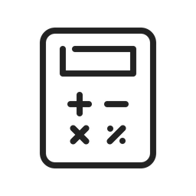


Numerical Methods
Numerical methods are mathematical procedures that seek an approximate solution to a mathematical problem.
They have a variety of applications
Current growth in computing power has enabled the use of more complex numerical methods.

Slide 5
Partial Differential Equations (PDE)
It is a mathematical representation of an unknown function that would involve two or more independent variables as well as include its partial derivatives of this function with respect to those independent ones.
The boundary condition of a partial differential equation can help us understand how a function behaves on the borders of its defining region.
This thesis studies the boundary conditions of:
Heat Equation:
Wave Equation:

Slide 6
03
Finite Difference Method

Slide 7
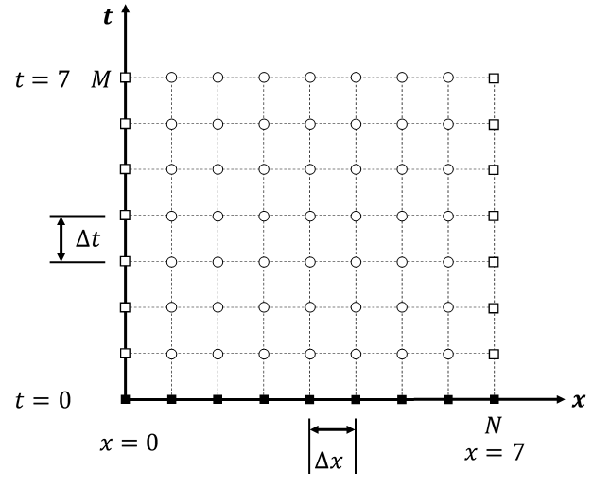
Finite Difference Method (FDM) - Overview
The PDE is replaced with a discretized domain → The approximate solution is only known at a finite number of points
The number of points can be freely selected → The details of the domain and the accuracy increase with the number of points
The discretized solution gives out a system of algebraic equations → Which can be solved with common mathematical methods
The flexibility of the finite difference method allows for better treatment of PDE with different initial and boundary conditions (Lee, 1993)

Slide 8
Finite Difference Method (FDM) - Schemes
First Order Forward Difference
First Order Backward Difference
First Order Central Difference
Second Order Central Difference

Slide 9
04
Heat Equation

Slide 10
Heat Equation – Approximations
Non-discretized heat equation:
Approximating the left hand side using the forward difference:
Approximating the right hand side using the central difference:
Substiuting back and solving for :
CFL=0.3

Slide 11
Heat Equation – Boundary Conditions
Dirchtlet boundary conditions – Constant tempature
Neumann boundary condition – No change in temperature

Slide 12
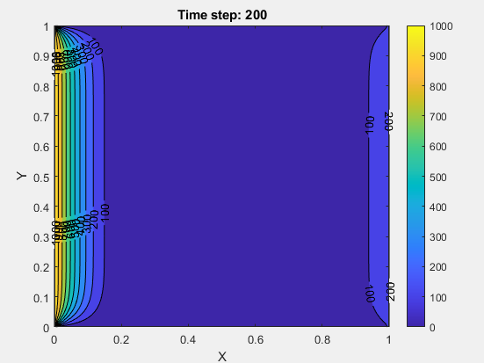
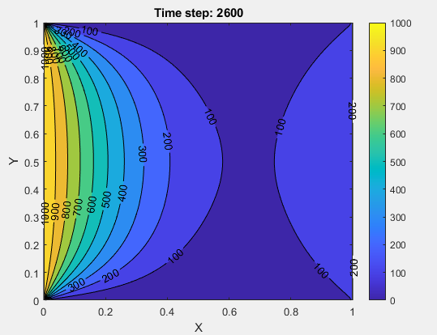
Heat Equation – Analysis
One-dimensional version

Slide 13
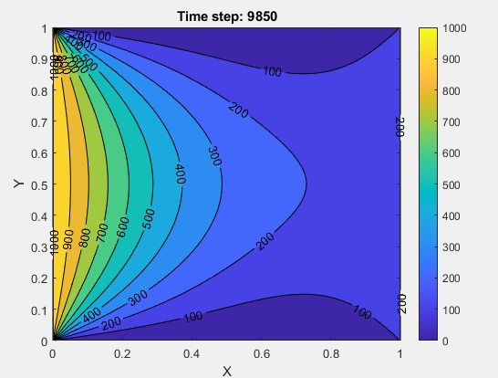
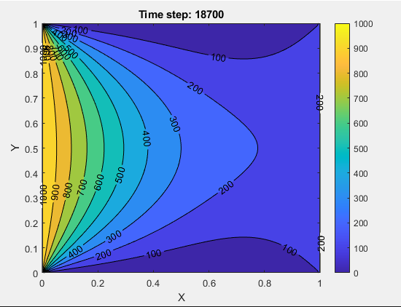
Heat Equation – Analysis
Steady State

Slide 14
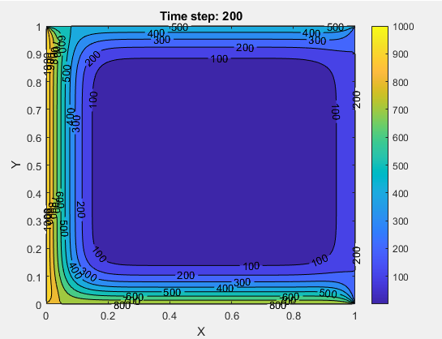
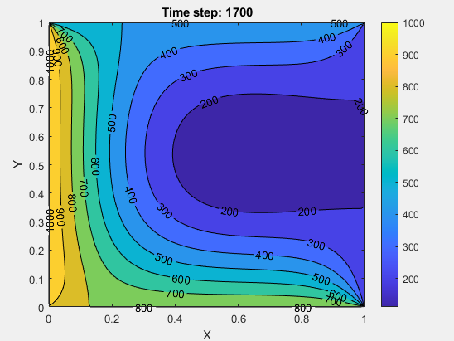
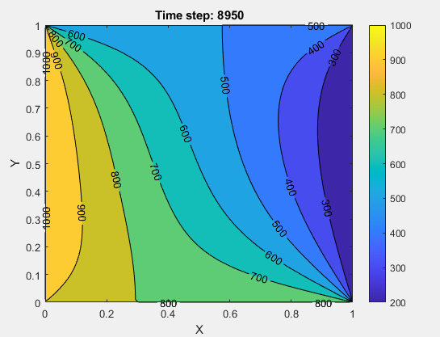
Heat Equation – Analysis
2D Dirchtlet boundaries

Slide 15
05
Wave Equation

Slide 16
Wave Equation – Approximations
Non-discretized wave equation (with a source):
Approximating the left hand side using the central difference:
Approximating the right hand side using the central difference:
Substiuting back and solving for :
Source:

Slide 17
Wave Equation – Boundary Conditions
Dirchtlet boundary conditions – Reflection
Mur boundary condition – Absorption

Slide 18
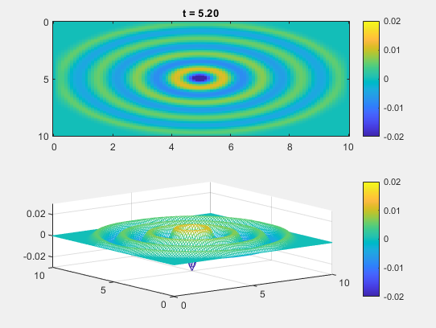
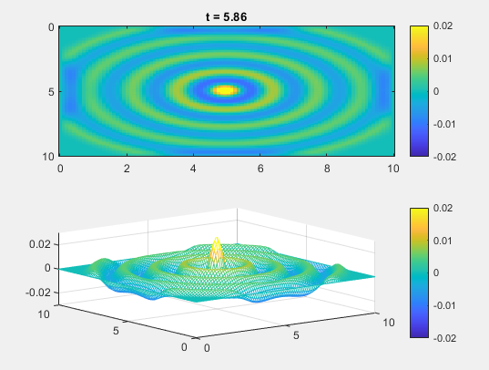
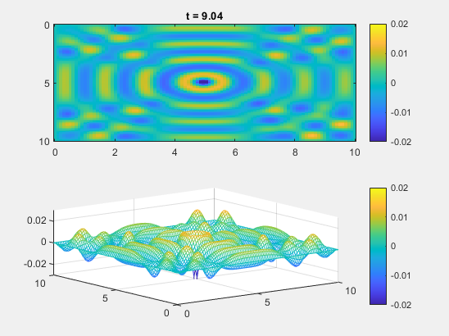
Wave Equation – Analysis
Dirchtlet Condition with source at the center

Slide 19
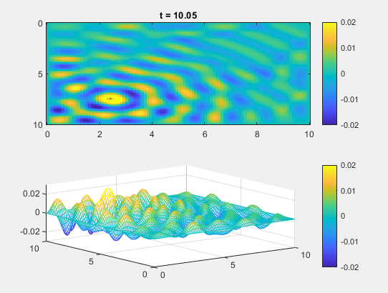
Wave Equation – Analysis
Dirchtlet Condition with source at the bottom left corner

Slide 20

Wave Equation – Analysis
Mur Condition

Slide 21
06
Conclusion

Slide 22
Conclusion
The effects of boundary conditions have been observed to play an important role in defining these fundamental equations.
Heat equation: the mixed combination of Neumann and Dirichlet can provide a basis for understanding heat transfer
Wave equation: the Dirichlet and Mur boundary conditions can provide the basis for many of the wave related phenomena
Future Improvements
Utilizing a different coordinate system
Combining many PDEs
Incorporating other boundary conditions

